Slide 1

04. Commands and man pages
Linux for Windows Admins

Slide 2
Man pages
Man stands for manual
Man pages are documents that offer information about what a command does and how to use it
They are installed on the OS so no internet is required to read them

Slide 3
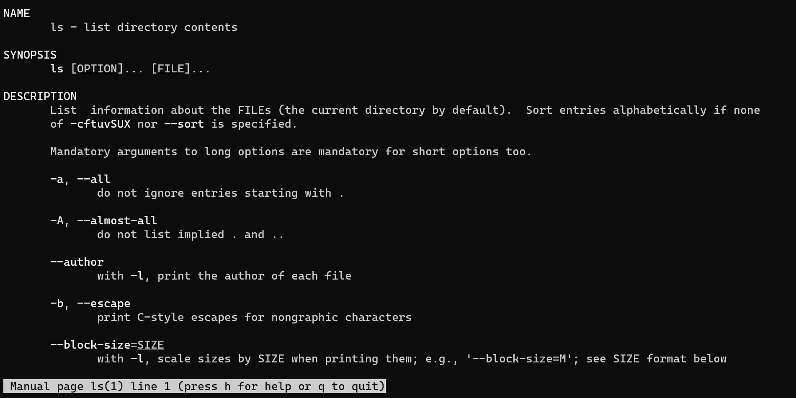
Man pages

Slide 4
Man pages
Use Enter to scroll the screen line by line
Use Space to go to the next screen
Use q to quit the man page
Type / and a search word, then Enter to search the man page for your word; Use n to go to the next occurrance

Slide 5
https://www.youtube.com/channel/UCcZ-jLbPwNr8E_v9-65n8Iw https://github.com/itknowledge4

